Slide 1
XHTML or HTML5?
Because XHTML documents need to be well formed, you can parse them using standard XML parsers
Unlike HTML, which requires a lenient HTML-specific parser.
For this reason, XHTML never really caught on, and when the time came to devise a new standard, the World Wide Web Consortium chose to support HTML5 rather than the newer XHTML2 standard.
HTML5 > XHTML2

Slide 2
XHTML or HTML5?
HTML5
Has some of the features of both HTML4 and XHTML
It is much simpler to use
It’s less strict to validate
Last but not least, there is just a single document type you need to place at the head of an HTML5 document, namely:
<!DOCTYPE html>

Slide 3
XHTML or HTML5?
For all intents and purposes, when writing HTML documents, web developers can safely ignore the old XHTML document types and syntax (such as using <br /> instead of the simpler <br> tag)
But if you find yourself having to cater to a very old browser or an unusual application that relies on XHTML, then you can get more information on how to do that at http://xhtml.com

Slide 5
MySQL
With well over 10 million installations, MySQL is one of the most popular database management system for web servers.
Developed in the mid-1990s, it’s now a mature technology that powers many of today’s most-visited Internet destinations.
One reason for its success must be the fact that, like PHP, it’s free to use.
But it’s also extremely powerful and exceptionally fast—it can run on even the most basic of hardware, and it hardly puts a dent in system resources.
MySQL is also highly scalable, which means that it can grow with your website (for the latest benchmarks, see http://mysql.com/why-mysql/benchmarks).

Slide 6
MySQL Basics
A database is a structured collection of records or data stored in a computer system and organized in such a way that it can be quickly searched and information can be rapidly retrieved.
The SQL in MySQL stands for Structured Query Language
This language is loosely based on English and also used in other databases such as Oracle and Microsoft SQL Server.
It is designed to allow simple requests from a database via commands such as:
SELECT title FROM publications WHERE author = 'Charles Darwin’;

Slide 7
MySQL Basics
A MySQL database contains one or more tables, each of which contains records or rows.
Within these rows are various columns or fields that contain the data itself.

Slide 8
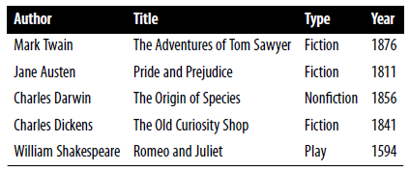
MySQL Basics
This table shows the contents of an example database of five publications detailing the author, title, type, and year of publication.
Each row in the table is the same as a row in a MySQL table, and each element within a row is the same as a MySQL field.

Slide 9
MySQL Basics
Name of the database:
To uniquely identify this database, I’ll refer to it as the publications database
Name of the Table:
And, as you will have observed, all these publications are considered to be classics of literature, so I’ll call the table within the database that holds the details classics

Slide 10
Summary of Database Terms
The main terms you need to acquaint yourself with for now are as follows:
Database The overall container for a collection of MySQL data
Table A sub-container within a database that stores the actual data
Row A single record within a table, which may contain several fields
Column The name of a field within a row
DISCLAIMER: I should note that I’m not trying to reproduce the precise terminology used in academic literature about relational databases, but just to provide simple, everyday terms to help you quickly grasp basic concepts and get started with a database.

Slide 11
Accessing MySQL via the Command Line
There are three main ways in which you can interact with MySQL:
Using a command line
Via a web interface such as phpMyAdmin
Through a programming language like PHP

Slide 12
Starting the Command-Line Interface Windows users
If you installed XAMPP, you will be able to access the MySQL executable from the following directory:
C:\xampp\mysql\bin
By default, the initial MySQL user will be root and will not have a password set.
Seeing as this is a development server that only you should be able to access, we won’t worry about creating one yet.

Slide 13
Starting the Command-Line Interface Windows users
So, to enter MySQL’s command-line interface, select Start or Cortana→Run, enter CMD into the Run box, and press Return. This will call up a Windows command prompt.
From there, enter one the following:
C:\xampp\mysql\bin\mysql -u root
This command tells MySQL to log you in as user root, without a password.
You will now be logged into MySQL and can start entering commands.
Notes:
If you receive an error such as “Can’t connect to local MySQL server through socket,” you will need to first start the MySQL server

Slide 14
Starting the Command-Line Interface Windows users
To be sure everything is working as it should be, enter the following:
SHOW databases;
Notes:
Not necessarily capitalized

Slide 15
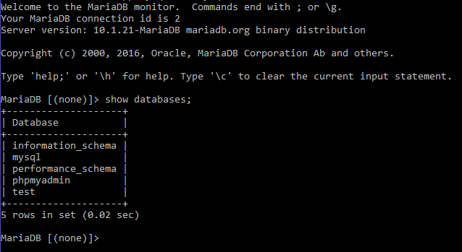
Notes:
MariaDB is a fork of MySQL

Slide 16
Starting the Command-Line Interface OS X users
To enter the MySQL command-line interface, start the Terminal program (which should be available in Finder→Utilities)
Then call up the MySQL program, which will have been installed in the directory:
/Applications/xampp/bin
By default, the initial MySQL user is root, and it will have a password of root too.
So, to start the program, type the following:
/Applications/xampp/bin/mysql -u root
Notes:
This command tells MySQL to log you in as user root and not to request your password.

Slide 17
Starting the Command-Line Interface OS X users
To verify that all is well, type the following:
SHOW databases;
Notes:
If you receive an error such as “Can’t connect to local MySQL server through socket,” you will need to first start the MySQL server

Slide 18
Starting the Command-Line Interface Linux users
On a system running a Unix-like operating system such as Linux, you will almost certainly already have PHP and MySQL installed and running, and you will be able to enter the examples in the next section
First you should type the following to log into your MySQL system:
mysql -u root –p
This tells MySQL to log you in as the user root and to request your password.
If you have a password, enter it; otherwise, just press Return.
Once you are logged in, type the following to test the program:
SHOW databases;

Slide 19
Starting the Command-Line Interface MySQL on a remote server
If you are accessing MySQL on a remote server, you should Telnet (or preferably, for security, use SSH) into the remote machine, which will probably be a Linux/FreeBSD/Unix type of box.
Once in there, you might find that things are a little different, depending on how the system administrator has set the server up, especially if it’s a shared hosting server.
Therefore, you need to ensure that you have been given access to MySQL and that you have your username and password.
Armed with these, you can then type the following, where username is the name supplied:
mysql -u username –p
Enter your password when prompted. You can then try the following command:
SHOW databases;

Slide 20
Starting the Command-Line Interface MySQL on a remote server
There may be other databases already created, and the test database may not be there.
Bear in mind also that system administrators have ultimate control over everything and that you can encounter some unexpected setups.
For example, you may find that you are required to preface all database names that you create with a unique identifying string to ensure that you do not conflict with databases created by other users.

Slide 21
Starting the Command-Line Interface MySQL on a remote server
Therefore, if you have any problems, talk with your system administrator, who will get you sorted out.
Just let the sysadmin know that you need a username and password.
You should also ask for the ability to create new databases or, at a minimum, to have at least one database created for you ready to use.
You can then create all the tables you require within that database.

Slide 22
The semicolon
Let’s start with the basics. Did you notice the semicolon (;) at the end of the SHOW databases; command that you typed?
The semicolon is used by MySQL to separate or end commands.
If you forget to enter it, MySQL will issue a prompt and wait for you to do so.
The required semicolon was made part of the syntax to let you enter multiple-line commands, which can be convenient because some commands get quite long.

Slide 23
The semicolon
It also allows you to issue more than one command at a time by placing a semicolon after each one.
The interpreter gets them all in a batch when you press the Enter (or Return) key and executes them in order.
It’s very common to receive a MySQL prompt instead of the results of your command; it means that you forgot the final semicolon.
Just enter the semicolon and press the Enter key, and you’ll get what you want.

Slide 24
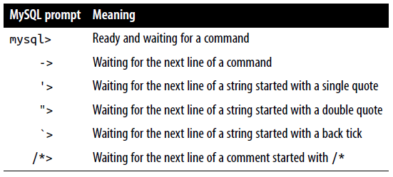
The semicolon
There are six different prompts that MySQL may present you with, so you will always know where you are during a multiline input.

Slide 25
Canceling a command
If you are partway through entering a command and decide you don’t wish to execute it after all, whatever you do, don’t press Control-C!
That will close the program.
Instead, you can enter \c and press Return
this is not MySQL command \c
When you type that line, MySQL will ignore everything you typed and issue a new prompt. Without the \c, it would have displayed an error message.

Slide 26
Canceling a command
Be careful, though:
If you have opened a string or comment, close it first before using the \c or MySQL will think the \c is just part of the string.
Also note that using \c after a semicolon will not work, as it is then a new statement.

Slide 27
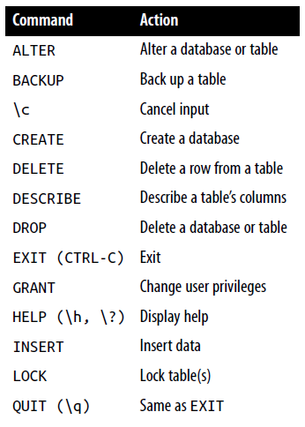
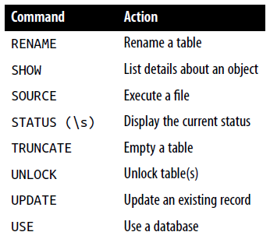
MySQL Commands

Slide 28
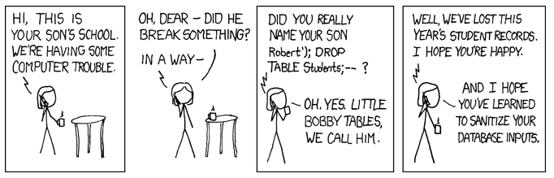
https://xkcd.com/327/

Slide 29
MySQL Commands
I’ll cover most of these as we proceed, but first, you need to remember a couple of points about MySQL commands:
SQL commands and keywords are case-insensitive
CREATE, create, and CrEaTe all mean the same thing.
However, for the sake of clarity, the recommended style is to use uppercase
Table names are case-sensitive on Linux and OS X, but case-insensitive on Windows.
So for portability purposes, you should always choose a case and stick to it
The recommended style is to use lowercase for tables.

Slide 30
Creating a database
Try issuing the following command to create a new database called publications:
CREATE DATABASE publications;
A successful command will return a message that doesn’t mean much yet:
Query OK, 1 row affected (0.00 sec)
Notes:
If you are working on a remote server and have only a single user account and access to a single database that was created for you

Slide 31
Creating a database
Now that you’ve created the database, you want to work with it, so issue the following:
USE publications;
You should now see the message:
Database changed

Slide 32
Creating users
Now it’s time to look at how you create users,
TIP: You need to create at least one user to let PHP access your database.
You don’t want to grant your PHP scripts root access to MySQL; it could cause a real headache should you get hacked.
To create a user, issue the GRANT command, which takes the following form (don’t type this in; it’s not an actual working command):
GRANT PRIVILEGES ON database.object TO 'username'@'hostname’
IDENTIFIED BY 'password’;

Slide 33
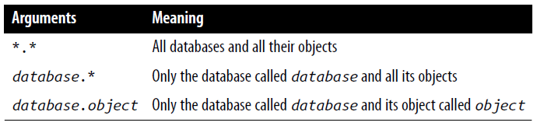
Creating users
GRANT PRIVILEGES ON database.object TO 'username'@'hostname’
IDENTIFIED BY 'password’;
This should be pretty straightforward, with the possible exception of the database.object part, which refers to the database itself and the objects it contains, such as tables.

Slide 34
Creating users
So let’s create a user who can access just the new publications database and all its objects, by entering the following (replacing the username jim and also the password mypasswd with ones of your choosing):
GRANT ALL ON publications.* TO 'jim'@'localhost’
IDENTIFIED BY 'mypasswd’;
What this does is allow the user jim@localhost full access to the publications database using the password mypasswd.

Slide 35
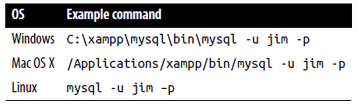
Creating users
You can test whether this step has worked following these steps:
Type quit to exit
Rerun MySQL with this command (jim is the username):
-u jim –p
Enter your password when prompted and you will be logged in.

Slide 36
Creating users
If you prefer, you can place your password immediately following the –p (without any spaces) to avoid having to enter it when prompted.
mysql -u jim -pmypasswd
But this is considered a poor practice, because if other people are logged into your system, there may be ways for them to look at the command you entered and find out your password.

Slide 37
Creating users
You can grant only privileges that you already have, and you must also have the privilege to issue GRANT commands.
There are a whole range of privileges you can choose to grant if you are not granting all privileges.
For further details, please visit the following site, which also covers the REVOKE command, which can remove privileges once granted: https://dev.mysql.com/doc/refman/5.7/en/grant.html
Also be aware that if you create a new user but do not specify an IDENTIFIED BY clause, the user will have no password, a situation that is very insecure and should be avoided.

